Slide 1
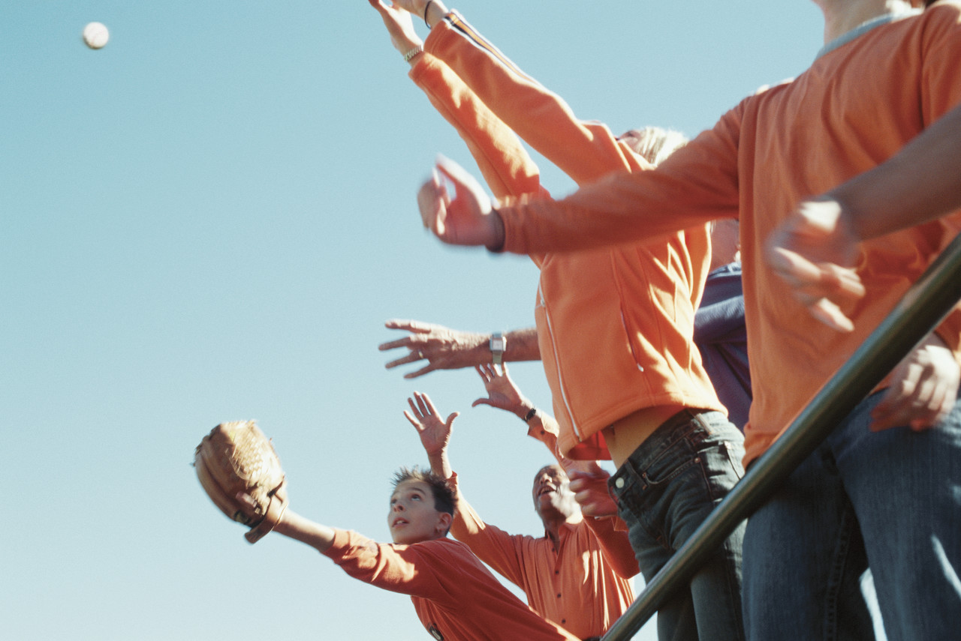
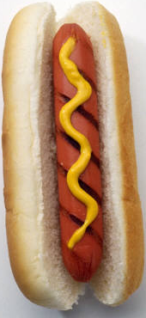

Keep Your Eye On The…Hotdog???

Slide 2
Kansas City Royals Fan Sues Over Hot Dog In Eye
Case: John Coomer v. Kansas City Royals Baseball Corporation
On September 8, 2009, John Coomer attended a Royals game with his father.
Instead of sitting in their ticketed seats, Mr. Coomer and his father sat in seats six rows behind the third base dugout.
Between the third and fourth innings, the Royals mascot “Sluggerrr” launched 20-30 hot dogs known as the“Hot Dog Launch”.
This is where our case begins!!

Slide 3

http://youtu.be/m96lz_PhOIs

Slide 4
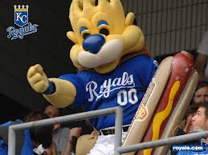
The Art of the Hot Dog Launch
20-30 hot dogs are launched to the fans, either through an air gun or by hand. Hot dogs launched through the air gun are wrapped in bubble wrap and the hand thrown hot dogs are wrapped in foil. There a number of types of throws used according to Mr. Shores, the man behind Sluggerrr: “overhand, over the shoulder, behind the back,….sidearm.”

Slide 5
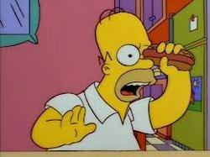
The Incident
While in front of the third base dugout, Sluggerrr began tossing hot dogs into the stands.
According to his testimony, Mr. Coomer looked away to the scoreboard and “a split second later” he was stuck by something in the face. The force of the impact knocked off his hat.
“Two morning later, Mr. Coomer noticed a problem with his vision. A tearing and detachment of his retina was subsequently diagnosed and he underwent surgery. He lost vision in his eye for about three weeks and subsequently developed a cataract. In December 2009, he had an additional surgery for the cataract and now has an artificial lens in his eye.” (John Coomer v. Kansas City Royals Baseball Corporation)

Slide 6
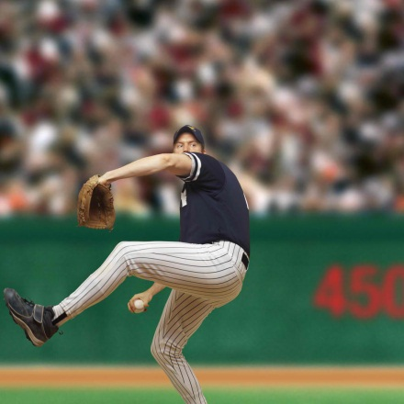
The Defense
Assumption of Risk: “An affirmation defense that the plaintiff cannot receive compensation for injuries from the defendant because the plaintiff freely and knowingly assumed the risk of injury and relieved the defendant of the obligation to act with reasonable care compare contributory negligence at negligence, volenti non fit injuria”.
Source: Merriam-Webster’s Dictionary of Law, 1996. Merriam-Webster, Incorporated. http://dictionary.findlaw.com/definition/assumption-of-risk.html

Slide 7
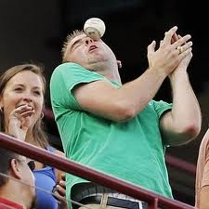
“Everyone who participates in or attends a baseball game assumes the risk of being hit by a ball” because “the risk of being hit by a baseball is a risk inherent to the game.” Sheppard by Wilson v. Midway R-1 Sch. Dist., 904 S.W.2d 257,262 (Mo. App. W.D. 1995)
“The Royals presented evidence to support a comparative fault instruction, i.e., that Mr. Coomer voluntarily chose to sit close to ‘the action,’ that he observed the hot dogs being thrown, that fans behind him were cheering for a throw, and that he looked away prior to the hot dog allegedly being thrown, despite facts from which it could be reasonably inferred a hot dog was about to be thrown.” (John Coomer v. Kansas City Royals Baseball Corporation)

Slide 8
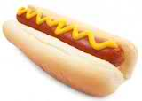
Food For Thought
Does being hit in the face by a hot dog an incidental risk of attending a baseball game?
Mr. Coomer argued that “risks created by throwing promotional items do not arise from the inherent nature of a baseball game.” (John Coomer v. Kansas City Royals Baseball Corporation)

Slide 9

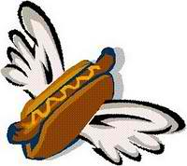
The Verdict
Jurors found in favor of the Defendant, Kansas City Royals Baseball Corporation. Apparently, getting struck in the face with flying hot dogs is an inherent risk of attending a baseball game.
                Mr. Coomer’s response? He appealed.

Slide 10
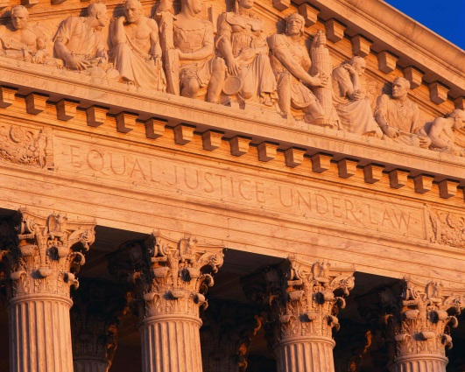
Missouri Court of Appeals Western District
On January 15, 2013, Mr. Coomer filed an appeal contending that the trial court erred by denying his motion for directed verdict and instruction error.

Slide 11
Instructional Error
Mr. Coomer raised four points to argue that the trial court erred in instruction.
  First, the trial court erred in instructing on the Royal’s defense of primary implied assumption of risk.
  Ruling: Granted and the judgment reversed.

Slide 12
Instructional Error, Cont.
.
  Second, if primary implied assumption of risk was available as a defense, the trial court erred because as it was submitted to the jury, the instruction was an incorrect statement of the law.
  Ruling: “Because we have determined that permitting the defense was not proper on these facts, Mr. Coomer’s second point is rendered moot and therefore denied.” (John Coomer v. Kansas City Royals Baseball Corporation)

Slide 13
Instructional Error, Cont.
  Third, the trial court erred in allowing and instructing on the Royal’s defense of secondary implied assumption of risk, comparative fault, “there was no evidence that Mr. Coomer acted unreasonable.” (John Coomer v. Kansas City Royals Baseball Corporation)
  Ruling: Denied. The royals presented evidence to support a comparative fault instruction. He chose to sit close to the actions, he knew that hotdogs were being thrown, and he looked away despite the fact that it could be reasonably inferred a hotdog was about to be thrown.

Slide 14
Instructional Error, Cont.
  Lastly, the trial court erred when in refused to instruct the jury on his claims for negligent supervision and training.
  Ruling: Denied. “the damage alleged by Mr. Coomer was confined to the actions of Mr. Shores and, consequently, the Royal’s liability for his training and supervision relied on a theory of imputed liability.” The trial court did not err. (John Coomer v. Kansas City Royals Baseball Corporation)

Slide 15
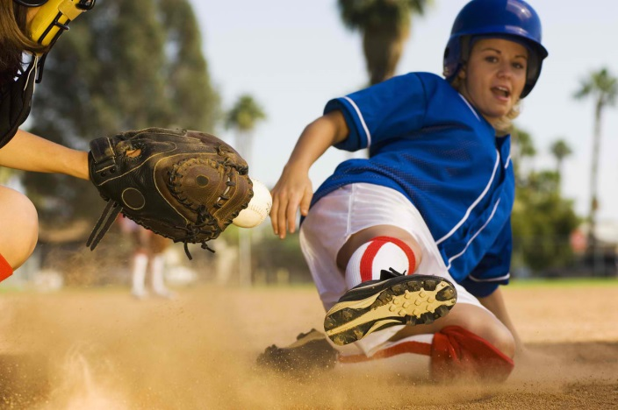
Conclusion – Home Run
The judgment was reversed and remanded for further proceedings.

